Slide 1

Wecome to Evolve Machine Learners
Evolve Machine Learners
Notes:
https://techxplore.com/news/2018-02-google-ai-heart-disease-pictures.html

Slide 2

Background
Education:
Oceanography ITB
Geophysics ITB
Jobs:
Field Engineer (Oil & Gas) at Quihandika
Freelance Geophysicist
Data Scientist at Aisensum
Data Scientist at Pomona
Website:
https://github.com/satriawadhipurusa

Slide 3
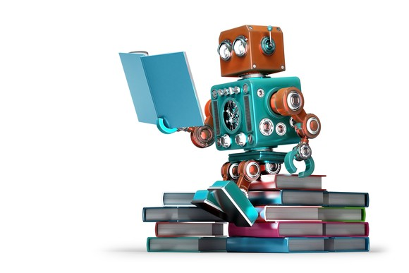
What is Machine Learning?

Slide 4
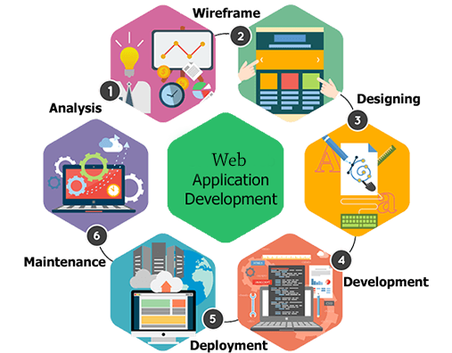
When a solutions works 100% of the time, NEVER USE MACHINE LEARNING

Slide 5
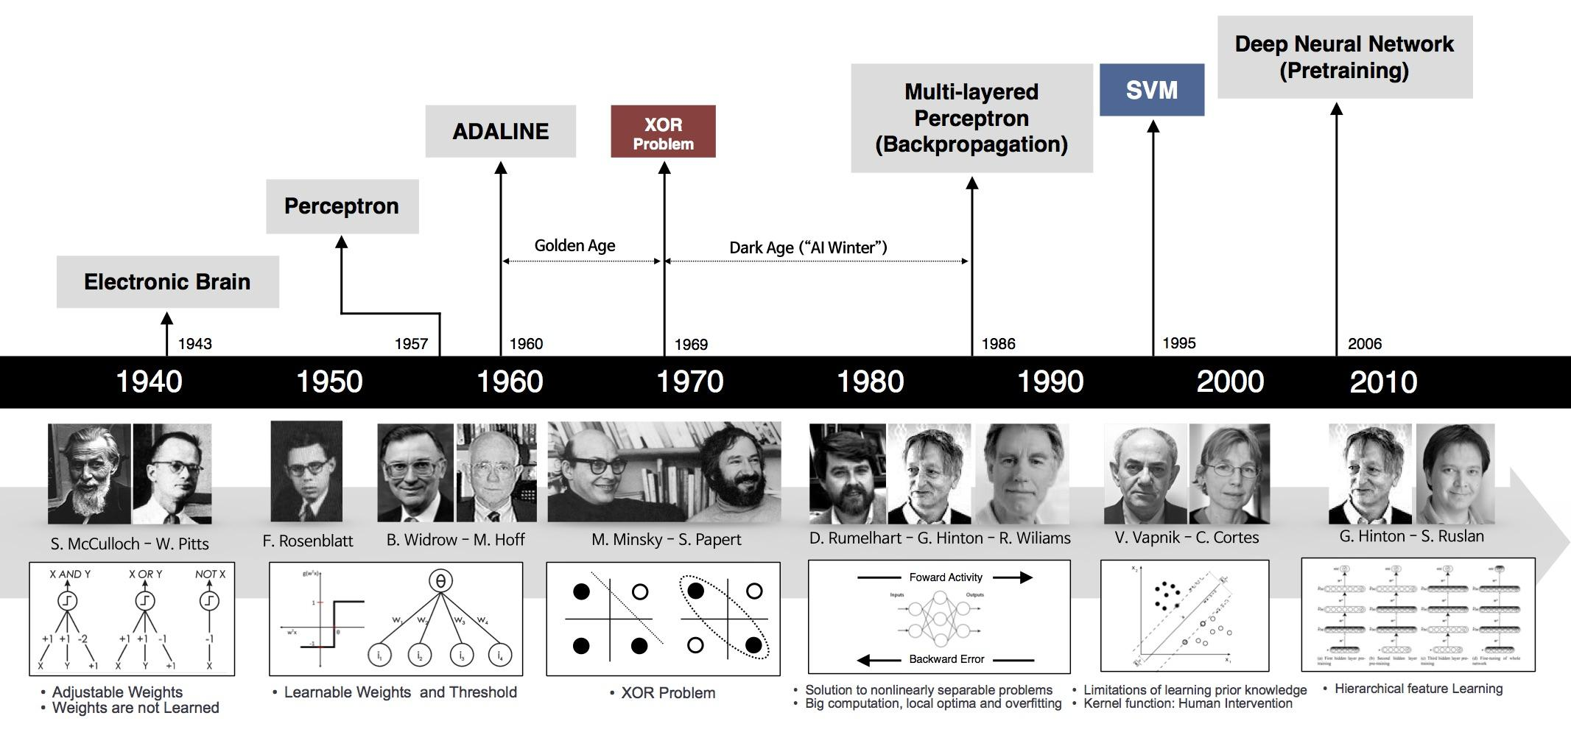

Slide 6
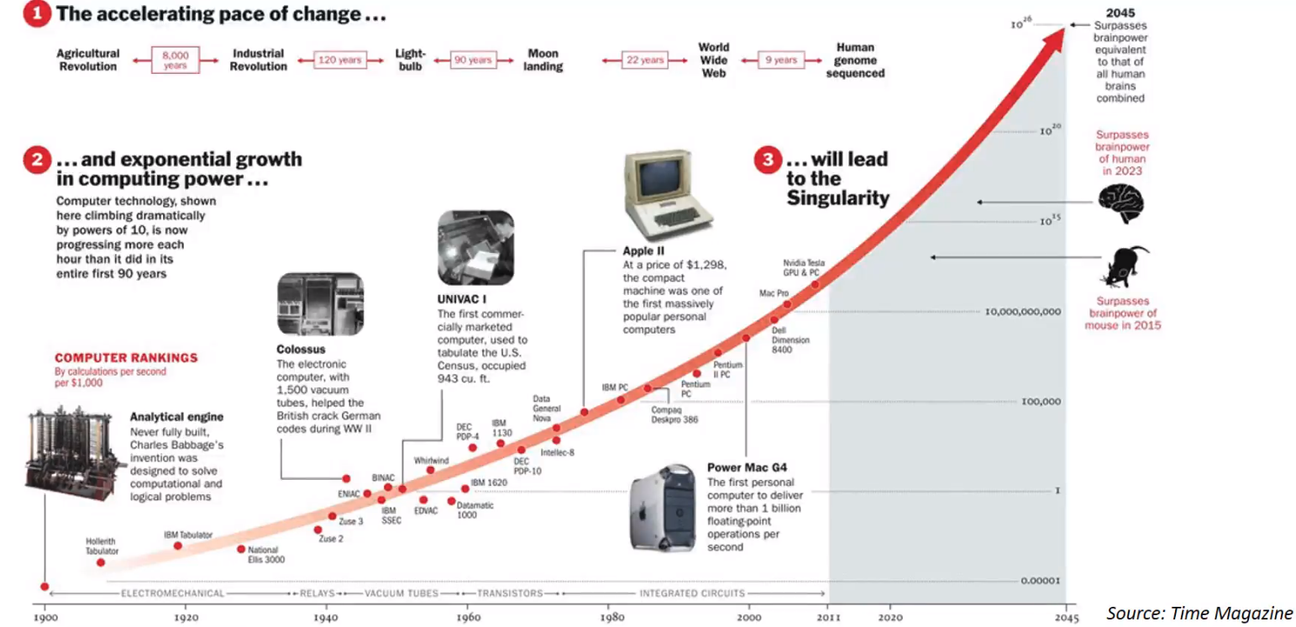

Slide 7
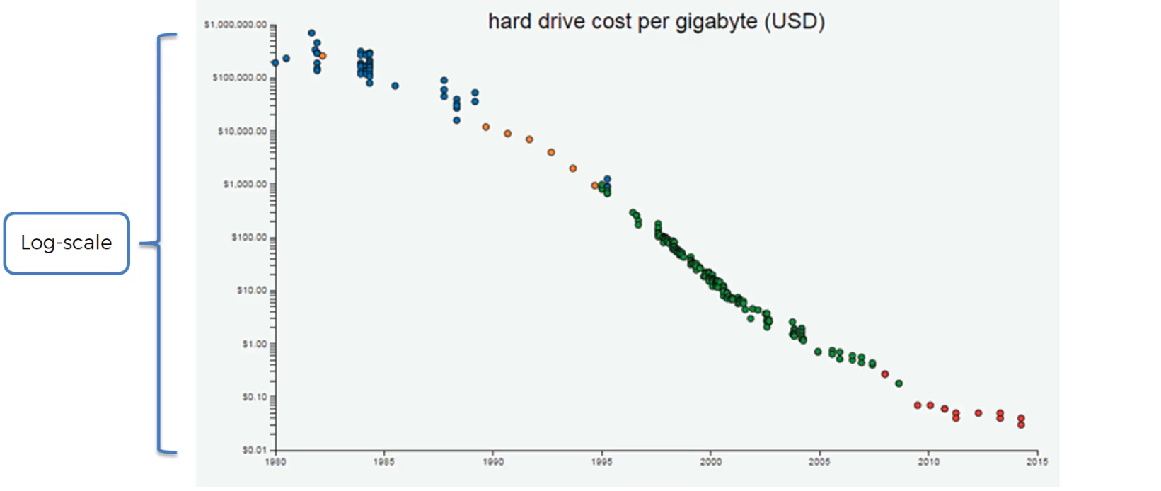
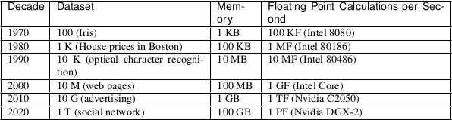

Slide 8
What are the use cases?
Weather predictions
Identify Images/Object
Question-Answer free-form text
User recommendations as they browse

Slide 9
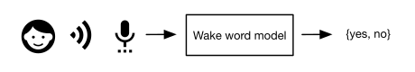
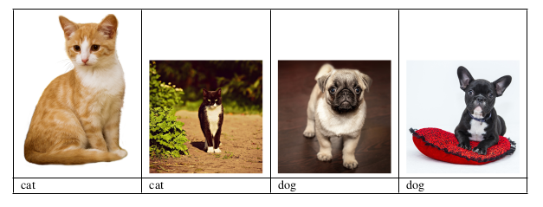
Programming with Data

Slide 10
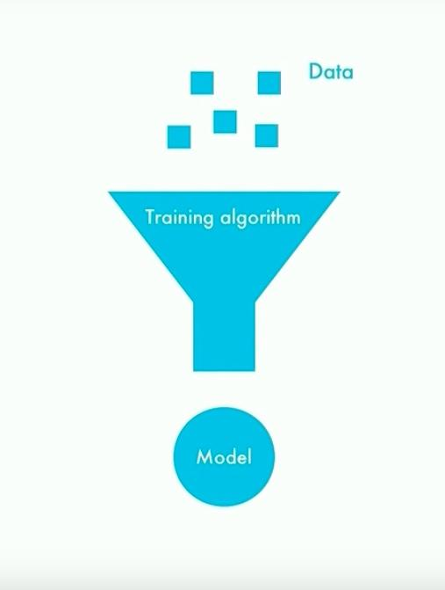
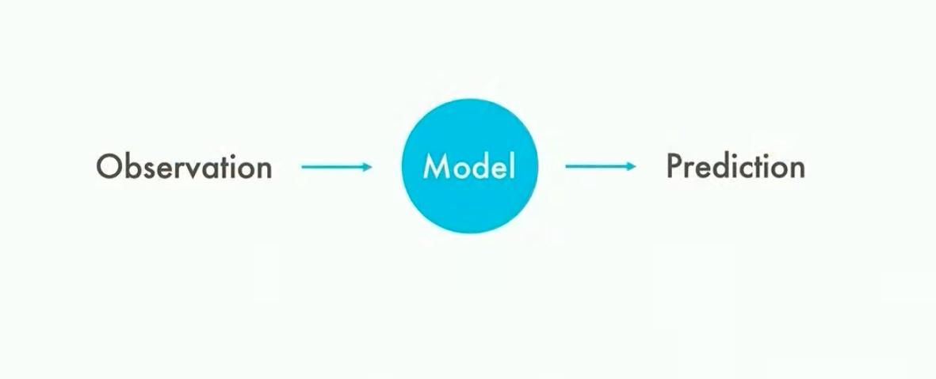
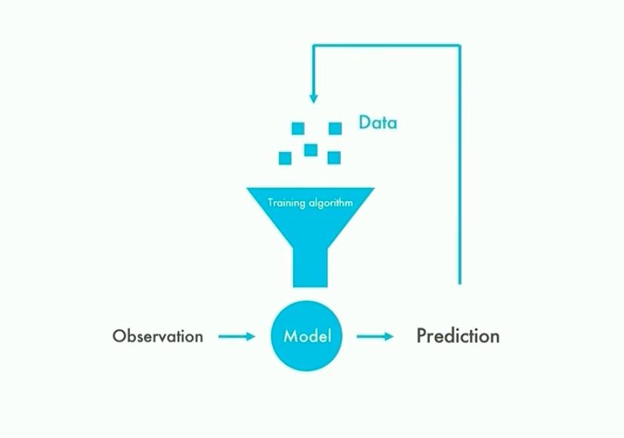
Notes:
https://www.youtube.com/watch?v=NVrxB9TomJM

Slide 11
Typical Machine Learning Steps
The data to learn
Model to transform the data
Loss function measure the badness of model
Algorithm to adjust model’s parameters to minize the loss

Slide 12
Types of Learning
Supervised Learning
Unsupervised Learning
Reinforcement Learning

Slide 13

Supervised Learning

Slide 14
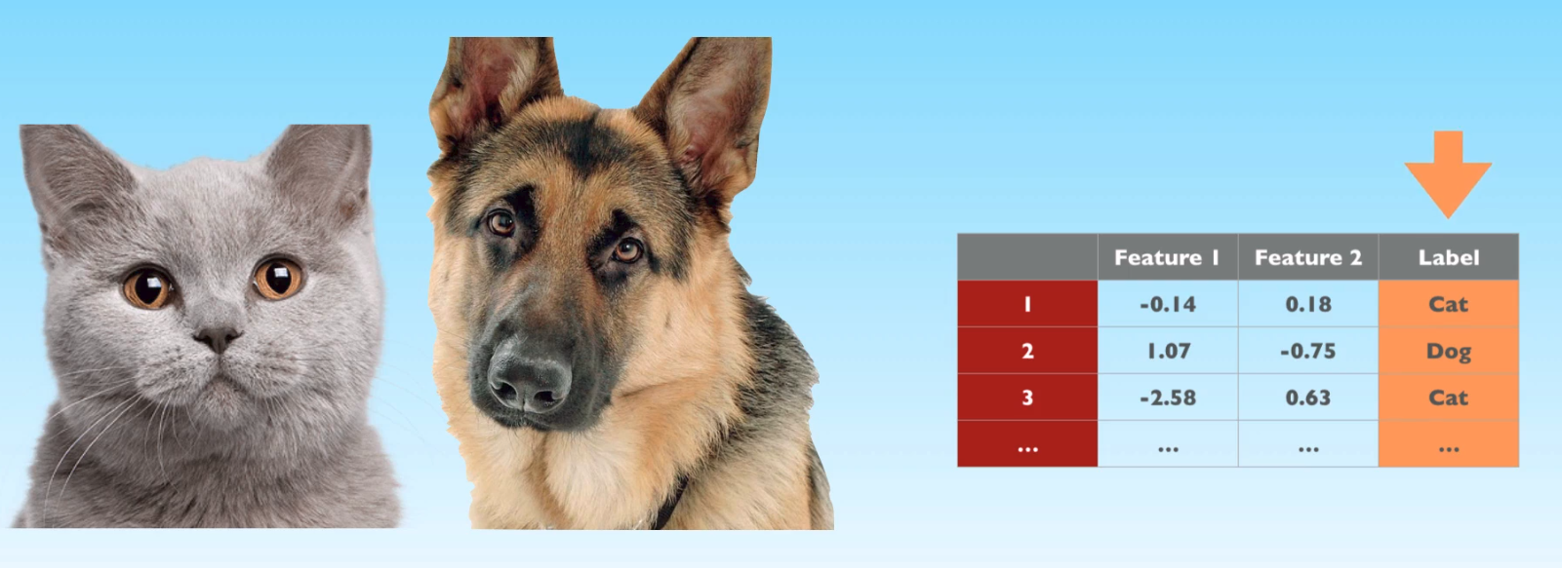

Slide 15
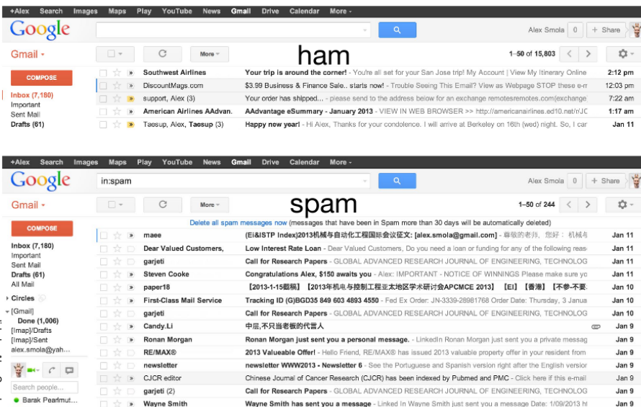

Slide 16

Unsupervised Learning

Slide 17
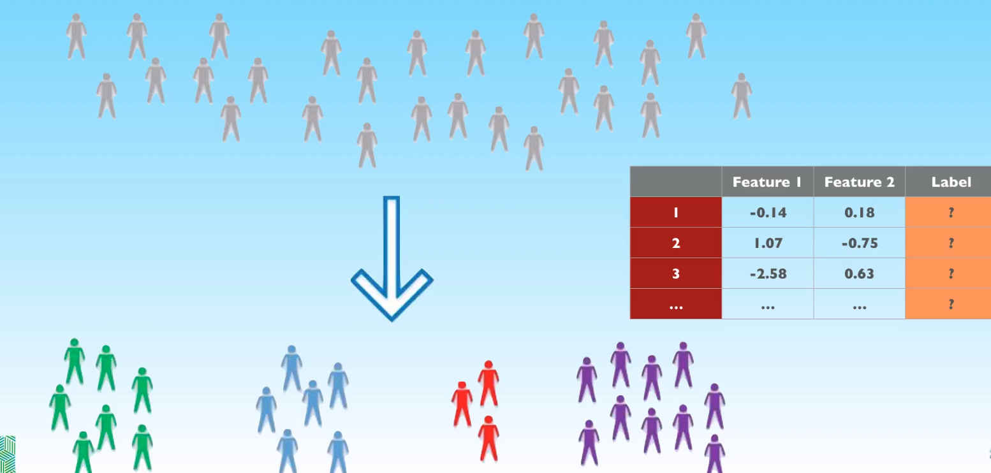

Slide 18

Reinforcement Learning

Slide 19


Slide 20
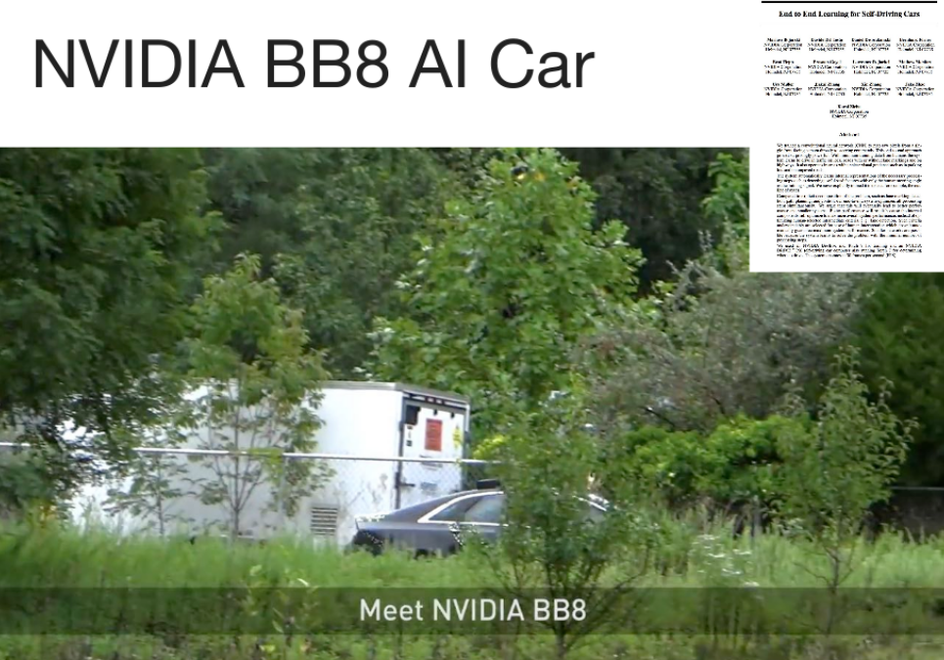

Slide 21
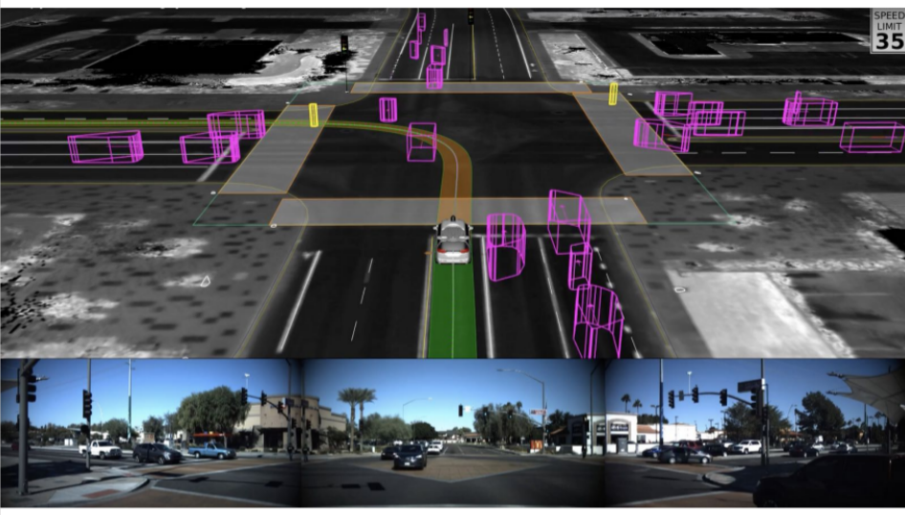

Slide 22
What is so special about AI?
AI→ Creates a positive feedback loop so we as humans can make better and better decisions...

Slide 23
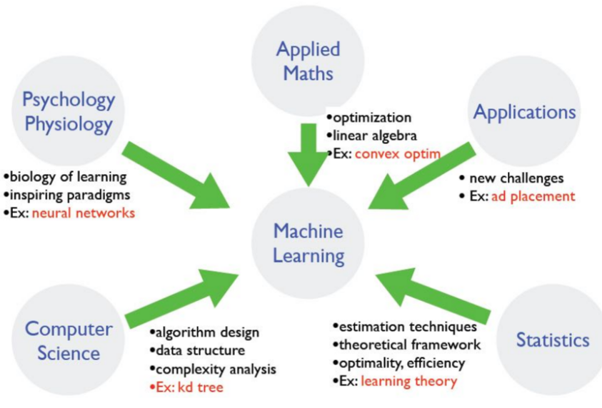
Where does ML fit in?

Slide 24
Install miniconda
https://conda.io/en/latest/miniconda.html
“conda env create -f env_eml_pytorch.yml”
“conda list”
“conda env list”
base
eml_pytorch
“activate eml_pytorch”
“source activate eml_pytorch”

Slide 25
